Slide 1
War Room to Boardroom
Conceived by Alan Roberts
Writer’s Guild of America East Reg. No. I236632
Contact: 917-524-4818 Alan@hearmuff.com

Slide 2
War Room to Boardroom
Tagline: “You’re hired!”

Slide 3
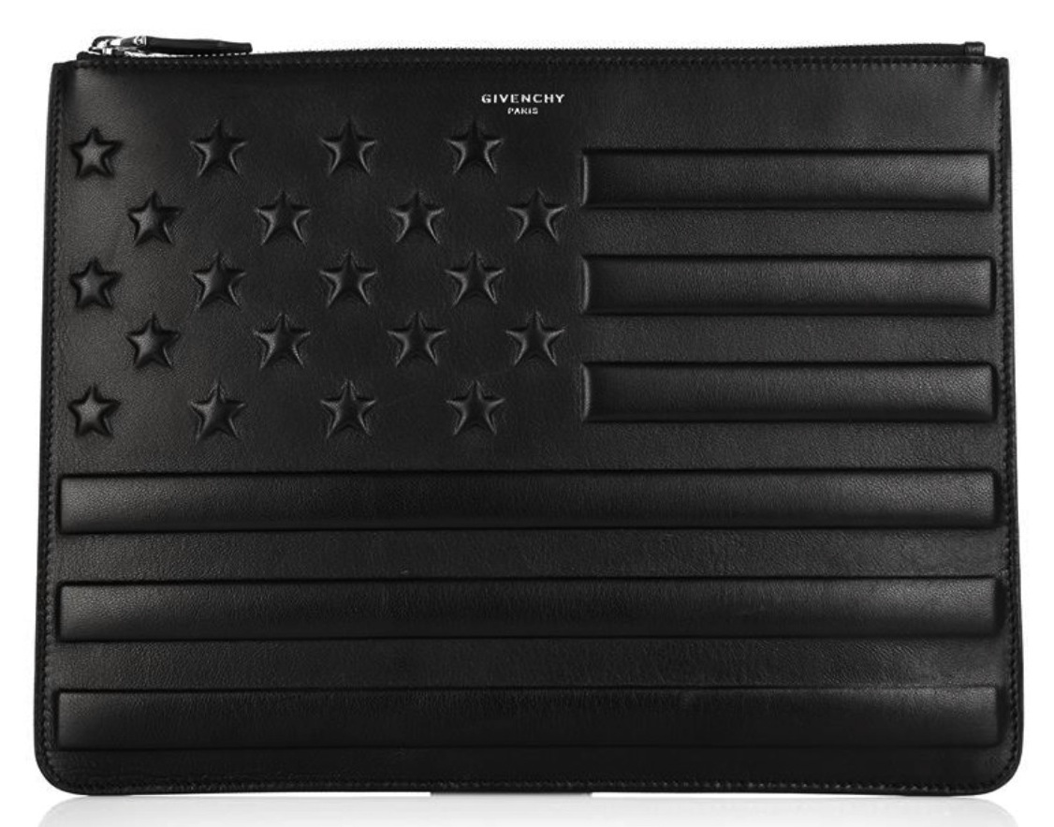
War Room to Boardroom
Format of Show: Multi-Episode, Single-Camera Docudrama
Logline: “The Apprentice” meets “Extreme Makeover”
This show follows the lives of 6 returning Iraq and Afghanistan war Veterans as they are trained by a professional career counselor, and assisted by various staffing agencies, to gain the necessary job skills required to obtain new careers.

Slide 4
War Room to Boardroom
Single Camera Format

Slide 5
War Room to Boardroom
Three Elements of a Successful Docudrama
Relatable Backstories
Real World Problems & Challenges
“Fly-on-the-Wall” Audience Participation
Examples Include:
“Pawn Stars”
“Bar Rescue”
“Pit Bulls & Parolees”

Slide 6
War Room to Boardroom
30% of returning Iraq and Afghanistan War Veterans 18-24 are unemployed.
Multiple tours of duty, long durations out of the job market.
Many young Vets are from rural and rust belt areas of the U.S.
Hiring executives view 6-8 years in the military as time missed learning corporate culture and “soft skills” required to excel in blue and non-blue collar roles.

Slide 7
War Room to Boardroom
“I need more time for this project.”
Words you won’t hear in a firefight.
Misjudged as ill-prepared for today’s technology driven workforce, yet highly disciplined and ready to carry out orders, Veterans often find themselves uncomfortable with:
Office Politics
Presenting to Peers
Confronting Superiors

Slide 8
War Room to Boardroom
Yet…
…many of the skills that make soldiers, male and female, successful on the battlefield, with proper direction, can translate to the boardroom.
This show conveys how professional training and proper guidance can make that happen.

Slide 9
War Room to Boardroom
The Concept
6 returning Veterans: 3 men and 3 women.
Each Vet meets individually and in groups to train with Mentors and professional Executive Coaches (Example: Dale Carnegie).
Each Veteran is assigned a Recruiter from TEL Staffing &HR.
At the conclusion of each show, the Veterans gather around a war room style conference table. One Vet and his/her Recruiter are told, “Congratulations, you’re hired!”

Slide 10
War Room to Boardroom
This is an aspirational show.
It will convey positivity.
No Gossip, Infighting
“One-for-All” Mentality
Personal & Professional Growth

Slide 11
War Room to Boardroom
What to Expect in Each Episode.
Tension
Drama
Competition
Positivity
This is real life drama, not a drummed up popularity contest. These are REAL people competing for REAL jobs to feed their families, not a vanity side project to launch their music or modeling careers.

Slide 12
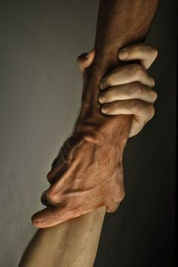
War Room to Boardroom
Battlefield to Breakroom.
Psychological counseling sessions will be mandatory for each Veteran on the show. This is a very important element of the series, and its dramatic arc cannot be overemphasized.
By the year 2012, Iraq and Afghanistan Veterans were committing suicide at a rate of one a day.
Highest ratio of any returning war veteran group in U.S. history.
An example of this may include a candidate who passes the show’s online and in-person interviews, yet does not transition well to a slow-paced environment or indecisive co-workers and managers.

Slide 13
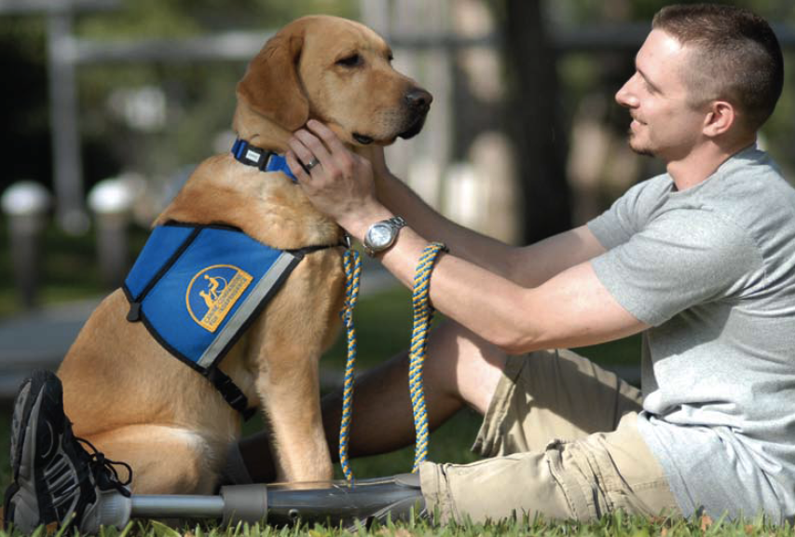
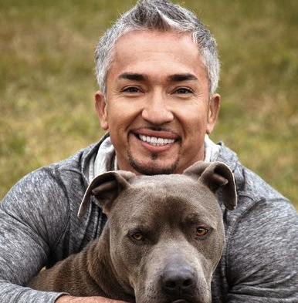
War Room to Boardroom
The New PTSD:
Professional Therapy, Smiling Dogs!
Therapy Dogs will enable scripted segments on the subject of reuniting Vets with the dogs they served with in combat. This recent military program has been met with extremely positive feedback Previously, animals were classified as “equipment,” making it very difficult for a returning soldier to gain ”ownership.”
These segments also allow well-known authors and TV personalities to confirm the healing powers of having an animal who served with you in combat placed by your side in the “Real World.”
(Example: Cesar Millan, The Dog Whisperer.)

Slide 14
War Room to Boardroom
Social Media & Web Presence.
Facebook page linked to all social sites.
YouTube Channel established, showing outtakes, between episode vignettes, and personal video diaries of each Vet.
Twitter accounts for each Vet. Potential bonus for the person with the most followers.
LinkedIn Members will be encouraged to submit job seeker advice, wardrobe tips, etc.

Slide 15
War Room to Boardroom
Powered By
Event Visualization & DigiPro Media.
Throughout the course of the series, the ability for all participants to interact via Event Visualization’s patented software will be made apparent to the viewing audience.
Tracking all social media via this software will also be part of the show, with separate segments that demo how the software is tracking viewership, in real time, through specific channels.

Slide 16
War Room to Boardroom
Hire Local. Local Support.
The Gulf Coast has the highest Military Veteran population, per capita, in the United States. Hence, Pensacola, FL, will be the location for Season One. Room and board to be provided by a sponsor (Example: DR Horton). When a Vet is hired, they receive two months rent, a sufficient professional wardrobe to get started (provided by a local clothier such as Don Alans), and a cash prize to go into a fund for ongoing education.

Slide 17
War Room to Boardroom
Add’l Local Sponsor Options

Slide 18
War Room to Boardroom
Big Picture Sponsor Options

Slide 19
War Room to Boardroom
Bringing Pensacola Together Via a Home Grown Television Show.
A show welcoming Veterans back into the community through professional development and new jobs can positively impact the entire Pensacola region. Try to name one local business that would not want to participate in an aspirational show of this nature.

Slide 20
War Room to Boardroom
“You’re Hired!”
A registered treatment with episode ideas, additional host and guest star opportunities, and sponsorship tie-ins can be seen by contacting:
Alan Roberts Alan@hearmuff.com 917-524-4818

