Slide 1

Connecting you and your family to safe, local transportation.
Investor Summary

Slide 2


Problem: Rideshare passengers do not feel safe
Almost 6,000 incidents of sexual abuse between 2017 and 2018
Passengers filing class action lawsuits claiming they were sexually assaulted by drivers
GoVetted Technology Inc. Proprietary and Confidential.

Slide 3

Problem: Rideshare companies can’t make money
No profitable quarters in the industry’s 10-year history
$1000 sign-up bonus per Driver
Average Driver is only active 15 hours a week
GoVetted Technology Inc. Proprietary and Confidential.

Slide 4
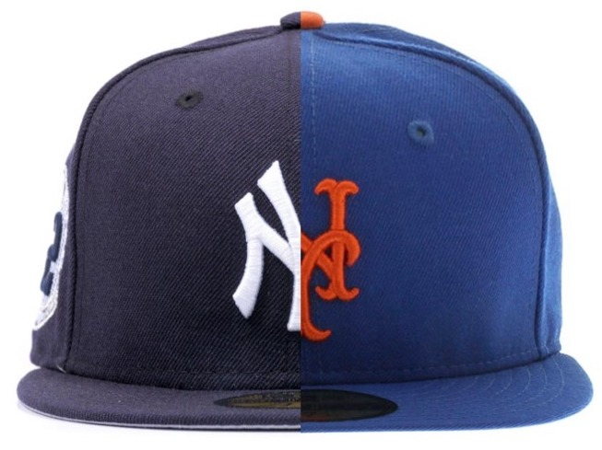
Problem: No brand loyalty
Customers choose whichever app provides fastest service
Current providers are in a race to the bottom on pricing
GoVetted Technology Inc. Proprietary and Confidential.

Slide 5

What’s the solution?
Create an app that provides safe, local transportation
Develop a revenue sharing program to increase Driver retention
Give customers the ability to personalize their in-vehicle experience and request specific Drivers
GoVetted Technology Inc. Proprietary and Confidential.

Slide 6

GoVetted is Safer
Drivers undergo the following:
• County, State & Federal Background Checks
• Terrorism Watchlist Check
• Sex Offender Background Check
• Pre-contract Drug Screening
• Periodic, Ongoing Spot Checks
GoVetted Technology Inc. Proprietary and Confidential.

Slide 7

GoVetted is Profitable
2019 Revenue (May – Dec.): $950K
No. of Trips: 12,000+
Revenue Increase Over 2018: 30%
GoVetted Technology Inc. Proprietary and Confidential.

Slide 8
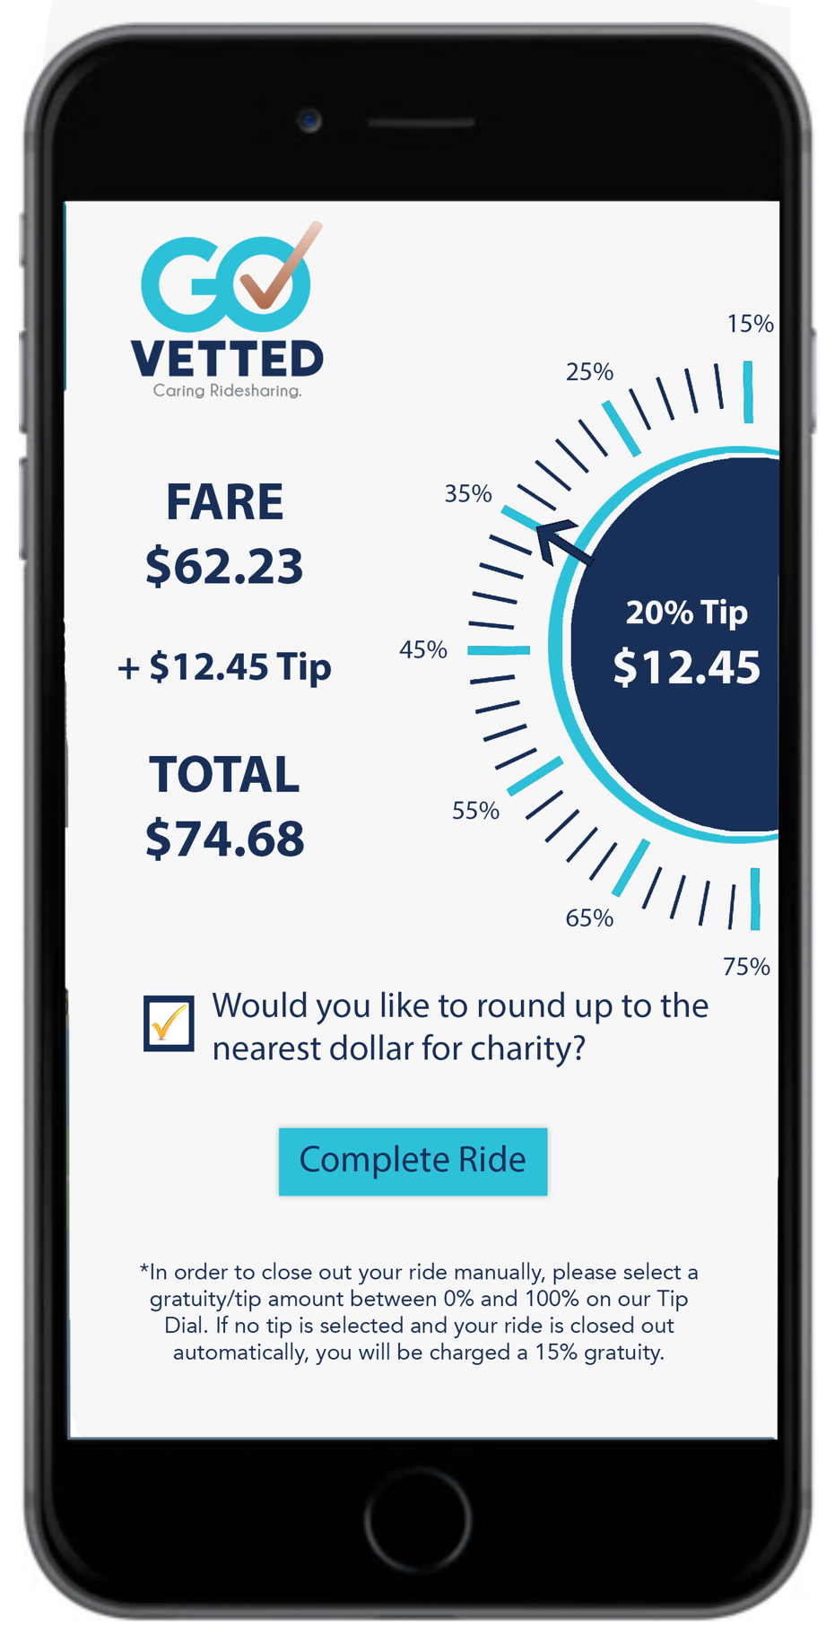
GoVetted Customers are Loyal
• 10-Point Driver Rating System
• Customers Can Select Favorite Driver
• In-Vehicle Preferences Stored in Profile
• Charitable Contribution “Round Up” Feature
• Peace of Mind: Their Driver Has Been Fully Vetted
• eWallet Feature (Store Funds, Purchase Trips for Friends)
GoVetted Technology Inc. Proprietary and Confidential.

Slide 9
Why Rideshare?
34% Increase in New Users
60.3 million
Total Addressable Market: $300 Billion
Those who took rideshare the previous year increase usage by app. 20% the next year.
45 million
GoVetted Technology Inc. Proprietary and Confidential.

Slide 10



Why GoVetted?
Team: 40+ years of professional ground transportation experience
Address 3 rideshare elements: Customers, Drivers, and Existing Transportation / Livery Companies
Our vetting process permits us to service the $5 billion Non-Emergency Medical Transportation (NEMT) market
GoVetted Technology Inc. Proprietary and Confidential.

Slide 11
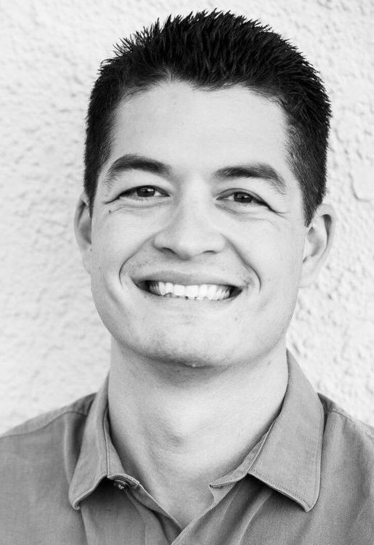
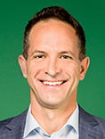
Why Now?
Only 20% of Americans have used rideshare.
• “Now is a good time for a new company to enter the marketplace.” Industry expert, Harry Campbell (“The Rideshare Guy” Podcast), Nov. 2019
• “Despite the safety concerns, according to our survey people are addicted to rideshare services.” Zander Lurie, CEO, SurveyMonkey, Dec. 2019
83% of U.S. consumers report convenience, not price, as the reason for using rideshare.
– McKinsey Quarterly
GoVetted Technology Inc. Proprietary and Confidential.

Slide 12
Key Differentiators
GoVested program provides residual income for Drivers who sign-up Drivers and Customers
The ONLY rideshare company drug screening its Drivers
In addition to independent Drivers, we partner with existing professional ground transportation companies
Ongoing training includes CPR & First Aid, Customer Service, and Defensive Driving
With our widget, businesses book transportation for their customers / guests, in exchange for ride credits
GoVested Drivers start their own business with no major investment and no product to buy.
GoVetted Technology Inc. Proprietary and Confidential.

Slide 13
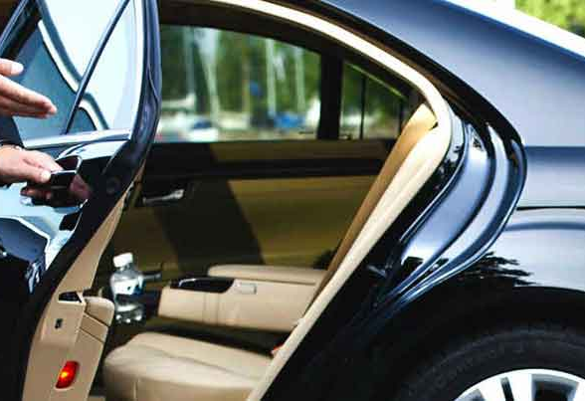
Operating Principles
Keep you safe
Give Drivers a legitimate business opportunity
Our brand becomes the “Apple of Rideshare”
Grow ridership among female and elderly demographics
Contribute to charities throughout our service areas
Become the most user-friendly app in rideshare
Make Florida the safest rideshare state in the U.S.
Change America’s perception of rideshare
GoVetted Technology Inc. Proprietary and Confidential.

Slide 14

Panama City Beach to Destin/Fort Walton
Revenue: $942,000
Trips: 12,000
Avg. Fare: $78.50
Days: 229
Trips Per Day: 49
Drivers on Platform: 86
Launch Date:
May 1, 2019
GoVetted Technology Inc. Proprietary and Confidential.

Slide 15
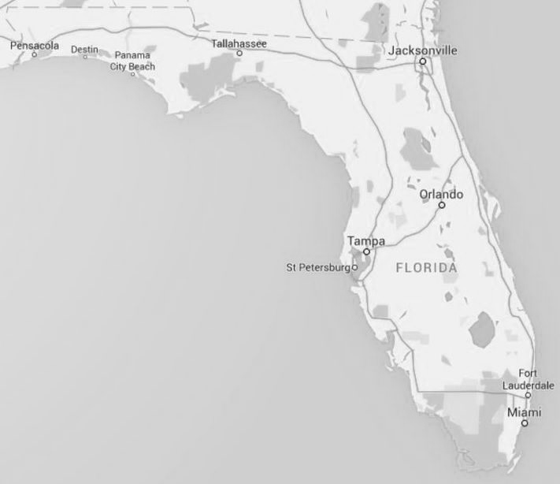
2020 Roll-Out
Add Key Management Personnel
Expansion in State of Florida
Implement Go-To Market Strategy
Customization of New Technology Platform
GoVetted Technology Inc. Proprietary and Confidential.

Slide 16

$2,000,000 Seed Funding
  10% Interest Due at Payoff
40% Class A Stock Will Be Given
  30% Collateral for Loan
  +10% Retained Equity at Payback of Loan and Interest for Investor
We Are Seeking:
GoVetted Technology Inc. Proprietary and Confidential.

Slide 17
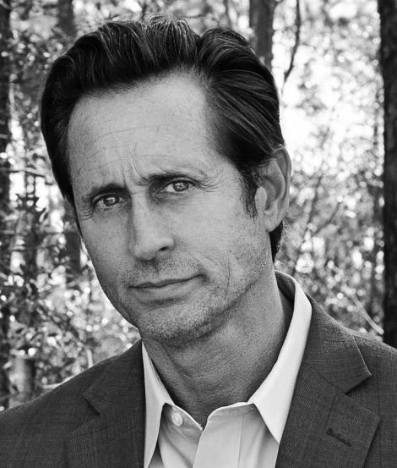
GoVetted CEO John Finch
A serial entrepreneur
Over 17 years of experience in transportation industry
Named to Inc. Magazine’s list of “America’s Fastest Growing Private Companies”
Early adopter of ground transportation reservation software
Board Member of Florida Limousine Association
Trusted consultant, advisor, and trainer in transportation industry
Trained thousands of drivers, from customer service to increasing revenue
John@GoVetted.com
850-699-2613

Slide 18



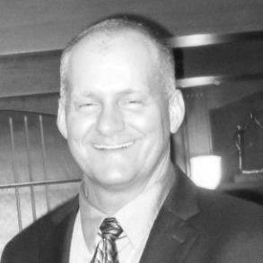
Team
A native of Florida’s Space Coast, Alan was VP, Marketing, during Sunshine Shuttle’s most profitable years, 2013-16 (John Finch’s previous company). His career includes successful sales and leadership roles at the Dale Carnegie Center of Excellence in New York City, premier online travel agent TripShock.com, T-Mobile, and AT&T. He enjoys golf, travel, cycling, and hunting down new and used vinyl records.
A dedicated, passionate and driven entrepreneur leading one of Tampa Bay's fastest growing media and marketing technology companies. With almost 20 years in the tech industry, Scott’s immersed himself in the ever-changing landscape of social, local and mobile trends to help businesses better connect with consumers locally and online. He lives by and instills in leadership his motto "Opportunities are not given, and they are not earned. Opportunities are created. They are created by our passion, perseverance and good will to others."
Scott Conlon
Consultant, Marketing
Alan Roberts
Chief Business
Development Officer
An experienced software engineer with a deep understanding of the whole web and mobile software development stack. With skills in Java EE backend services and native mobile development for both Android and iOS. Loves to craft RESTful APIs, and to design multithreaded software solutions. He has skills for what concerns the design of relational database, system administration, and the setup of cloud hosting solutions based on the AWS platform.
James has a BSME in Mechanical Engineering. He has worked successfully as an automation engineer manager in the plastics, metals, and automotive industry specializing in high speed automated robotic assembly and packaging. He developed a company to assembly, manufacture and sell highly sophisticated digital testing equipment. He is a business consultant who works as a turn-around specialist implementing solutions, training management, and teaching managerial accounting.
Luca Adamo
Advisor, Technology
James Richey
Consultant, Finance
We are Caring Ridesharing.

Slide 19
Questions?
“Rideshare drivers are struggling to get by. Everyday there’s something negative in the news. Companies needs to take better care of their drivers. All of us rideshare drivers complain about it, unfortunately, there is nothing we can do. There are no great alternative rideshare companies to join yet.”
Ryan Conner, Driver
RideshareNews.org
Nov 3, 2019

Slide 20
Company Stage: $500K - $1M Trailing Annual Revenue
Est. Pre-Money Valuation: $2.7M
Previous Capital Raised: $0
Amount of Capital Seeking: $2M
Monthly Burn Rate: $52K
2019 Revenue (May – Dec.): $900K
No. of Employees: 4
GoVetted Technology Inc. Proprietary and Confidential.

Slide 21
Trip Fare Breakdown
25%
$12.50
Example: $50
65%
$32.50
10%
$5
Drivers
Comp Plan / Marketing
GoVetted
GoVetted Technology Inc. Proprietary and Confidential.

Slide 22

Driver Recruitment & Retention
“Drive for Five”
We Charge More for Vetted Service
We Pay More (65%, No Fluctuations)
We Pay for Driver Referrals (Beginning at 4% Per Trip)
We Pay for Customer Referrals (1% Per Trip - Forever)
We Pay for Concierge Referrals (5% Per Trip - Forever)
GoVetted Technology Inc. Proprietary and Confidential.

Slide 23
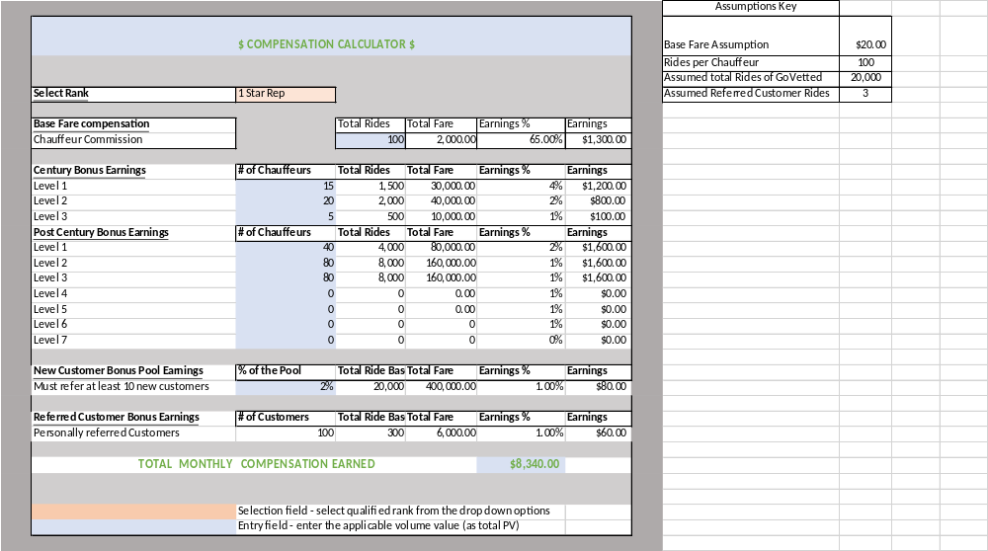
*Assumption 1 driver drives 5 trips per day paid at 65% of $15.00/Base Fare trip.
**Century AND Post Century; Century level falls off once each of your drivers hits 100 trips.
Driver Compensation Plan Example
GoVetted Technology Inc. Proprietary and Confidential.

Slide 24
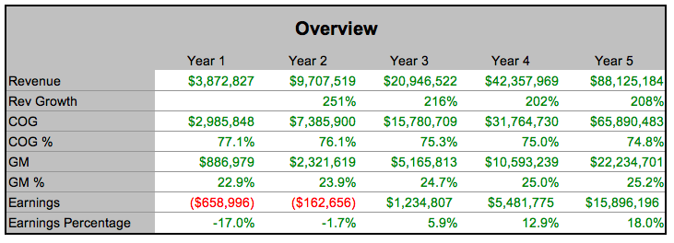
Pro Forma
GoVetted Technology Inc. Proprietary and Confidential.

Slide 25

Go To Market Strategy
Pre Launch
Launch
Growth
Establish Initial Plan, Roles, Processes
Market Research
Target Audiences
Refine roles & responsibilities
Identify local catalysts
Expand to the New Market
Roll out street team
Launch Party or Initiative
Events & Community Development
Grow the New Market
Market fully staffed and functional
Integrated Marketing with Back Office
Optimization of Driver/Rider Engagement
Recruit Roles:
Additional People/Partners
Fully staffed and managed local markets
Seasonal Team
People
Market Lead
Influencers & Catalysts
Brand Ambassadors
Concierge & Referrals
Affiliates
Foundational Processes
Additional processes
All processes defined and automated, where possible
Driver/Rider Communication streamlined
Processes
Driver Recruitment
Training & Resources
Communications
Content curation
Financial mgmt.
Customer escalation
Support
Market Budget
Feedback Loops
Tools
PR & Advertising Campaign
Daily/Weekly/Monthly Reporting
Social Media & Brand Management
Local team operating brand locally with dedicated support Market Manager in Corporate

Slide 26
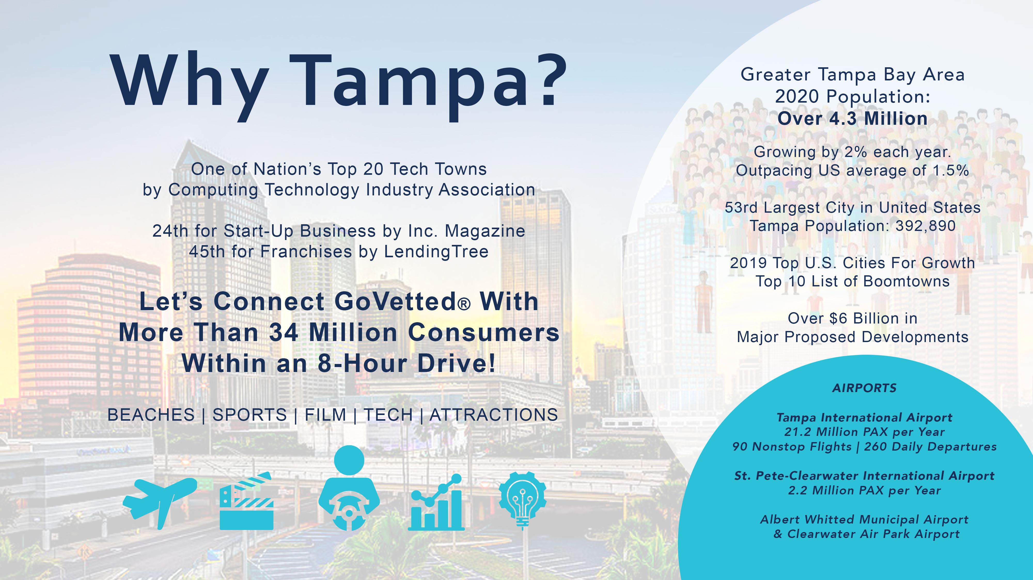

Slide 27
