Slide 1
Review Court
“Where the truth lies”
Digital Tv series
Coming 2020

Slide 2


the state of online reviews

Slide 3
Impact. Behavior. Engagement.*
Number of reviews posted by Yelp users is 26,380 per minute
Over half of young people aged 18 to 34 say they trust online reviews more than the opinions of friends and family
Reviews from experts and celebrities are less trusted than online reviews
88% of consumers trust reviews as much as personal recommendations (up from 83% in 2014)
30% of consumers assume online reviews are fake if there are no negative reviews
48% of consumers will visit a company’s website after reading positive reviews
88% of online shoppers incorporate reviews into their purchase decision
76% of consumers making $150K annually leave reviews when experiencing poor customer service
Reviews produce an average of 18% uplift in sales
If a business resolves its issue quickly and efficiently, 95% of unhappy customers return to the business
*Stats sourced from BrightLocal, Business2community, Bazaarvoice, webrepublic, reprevive, Econsultancy, business2community, Reevoo & Social Media Today. (Dec. 2019)

Slide 4

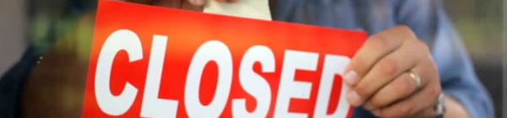
reviews are often so far in either direction it's impossible to know what’s real, and the discrepancy can destroy a business.

Slide 5
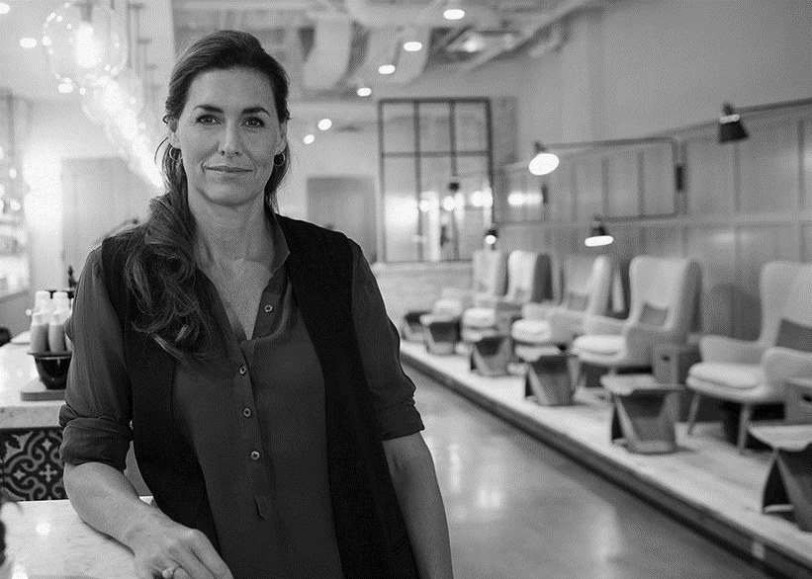


But One thing’s for sure…
Everybody uses reviews.
Business owners often disagree with what people say about them.
It doesn’t matter what your business is, but what people say your business is.

Slide 6

solution
A courtroom dramedy to determine
“Where the Truth Lies”

Slide 7
“Review court”
“Yelp” meets “Judge Judy”
3 revolving celebrity jurors (Comics, TV/Radio Hosts)
1 permanent cast member as the judge
Special guests appear in re-enactments (Comics, famous business owners, B-List celebrities)

Slide 8
“Review court”
Consumer and a business owner in a “courtroom” setting in a battle of wits, storytelling, and funny consequences.
Business owners who’ve experienced a bad review have the opportunity to defend themselves by confronting their “accuser.”
Each business owner (“Defendant”) can provide various examples of evidence, such as “character witnesses” who have written positive reviews on the same site detailing their good experience(s) with the business or service.
The consumer (“Plaintiff”) defends their review, providing witnesses (live or via video), evidence, borderline comical re-enactments with guest stars playing consumer and seller, etc., to make their case.
A Judge Judy-type character will oversee the proceedings, handing down a “verdict” during each episode’s finale.
Audience members will also vote on the outcome prior to the final ruling.

Slide 9
“Review court”
This show contains the three basic ingredients in making a successful Courtroom / Unscripted TV series:
Competition (“Winners & Losers”)
Human Drama / Consequences
Audience Participation
None of the outcomes will hold legal water, so to speak, as both parties will be required to sign waivers acknowledging no monetary damages of any kind will be rewarded. The outcome is neither a sign of “guilt” or “innocence.” (This is not “The People’s Court.”) The goals of the show are to 1) Entertain; and 2) Produce a satisfactory result for both parties. They will exit the stage with more understanding as to what occurred during their initial real-world transaction.

Slide 10
“Review court”
“Not Guilty vs. Guilty”
If a business owner is granted a “not guilty” verdict, they will be granted the right to delete the review, forever, and given a “Not Guilty - As Proven on Review Court” badge on their listing.
Spokespersons for these sites will be asked to verify “buy-in” on-air or via taped testimonials.
If the consumer’s review is “judged” to have veracity, the seller must admit wrongdoing and provide some type of non-monetary reimbursement.
The show’s sponsors can also provide “gifts” to make up for the consumer’s experience ̶ especially powerful if wedding or some other special occasion was ruined.
The review will stand, but with a badge indicating “Lesson Learned - As Seen on Review Court” with an “admission of guilt” from the seller.
The seller can also opt to present a written “confession” (“I was short staffed, food delivery never came, my mom had just died,” etc.) so the audience can see their side of the story, along with a link to their appearance on the show.

Slide 11
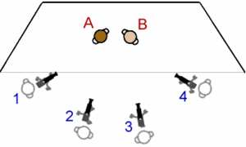
Multi-camera format
Shot to MIMIC an actual courtroom
22-minute episodes follow courtroom procedural format

Slide 12

audience
Urban
College Educated
Tech & Pop culture Savvy
Males and Females, 18-49
Fans of “drunk history,” “judge judy,” & Alt-Comedy

